Slide 1
IWPA 2013 - 2014 Championships

Slide 2
IWPA Regional Hall of Fame
2013 – 2014 Season

Slide 3
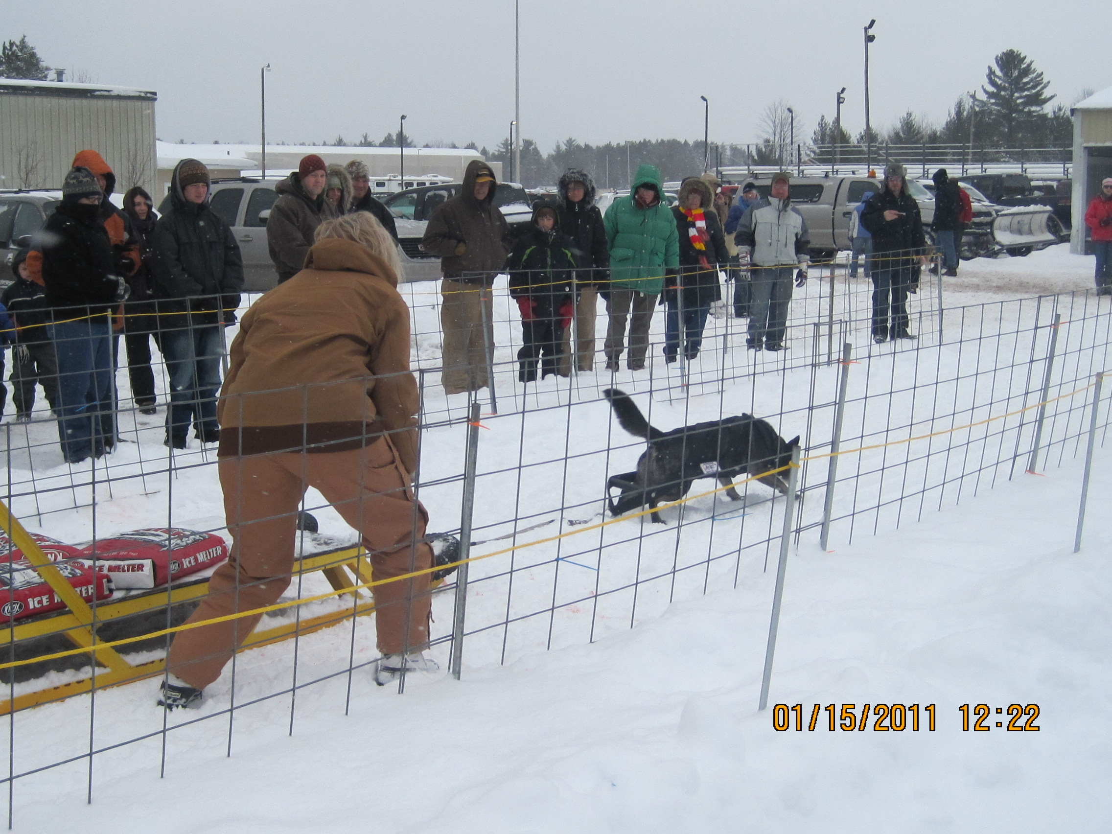
REGION 6 UAG11, UWPCHX, UWPS Orphan Annie, WD-W/S, WDE-W/S, WDS-W, CGC, TDI, TT, DSA, CHUDDN
Owner/Handler:
Sally Cole

Slide 4
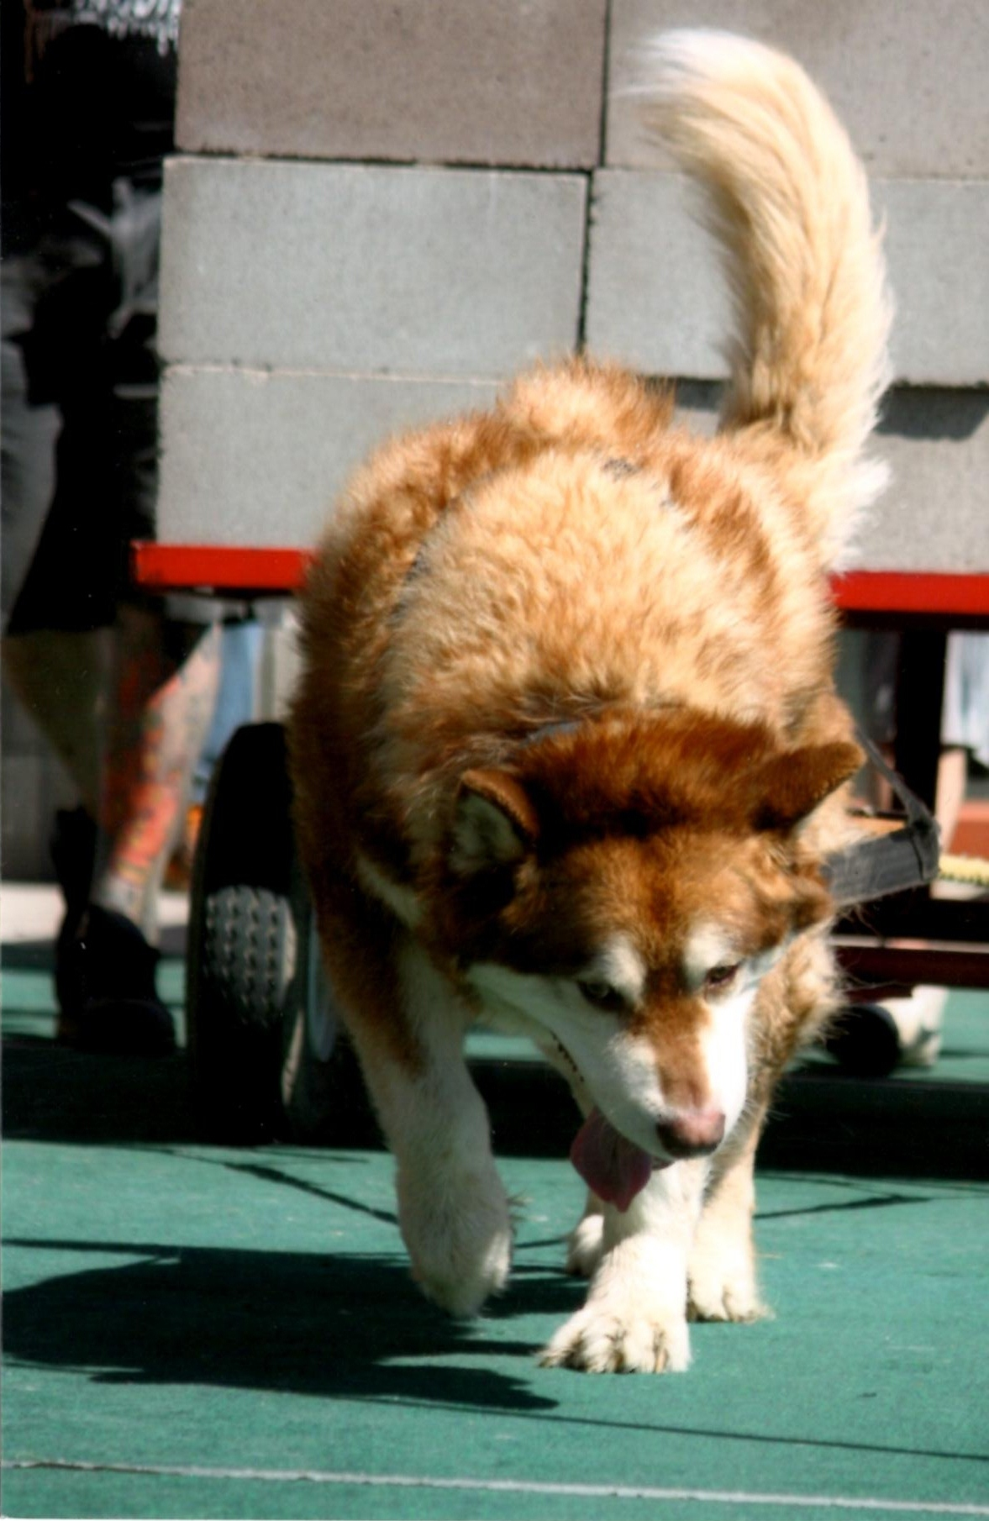
REGION 10 Cascade’s Shaman’s Dream
Owner/Handler
Jim Galli

Slide 5
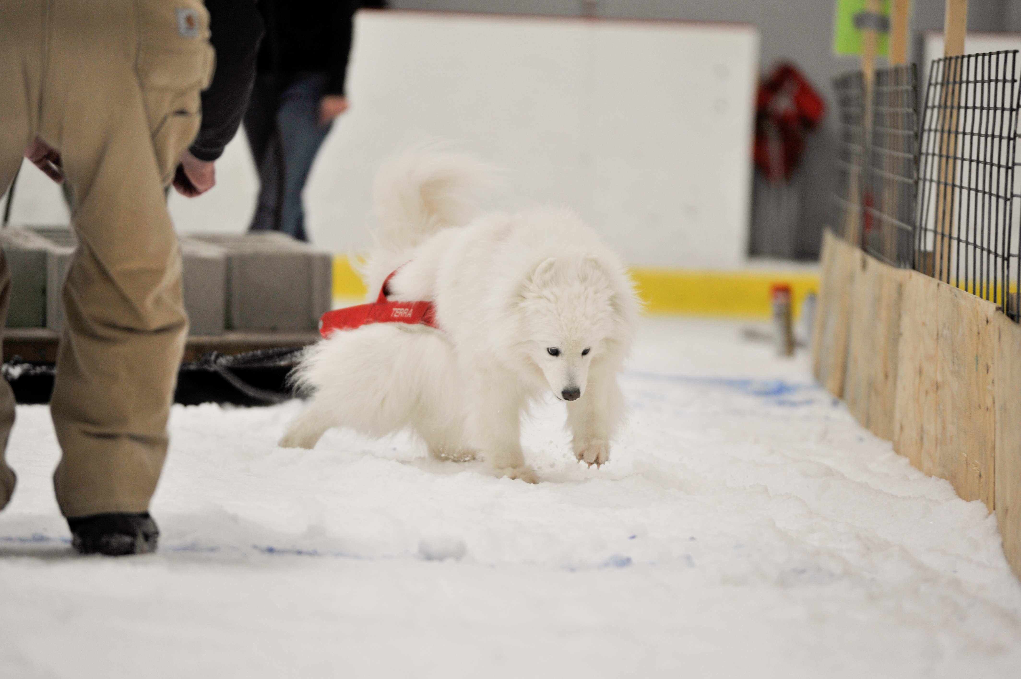
REGION 5 Windswepts “Terra” of Saranac
Owner/Handler
Daniel and Belva Plosila

Slide 6
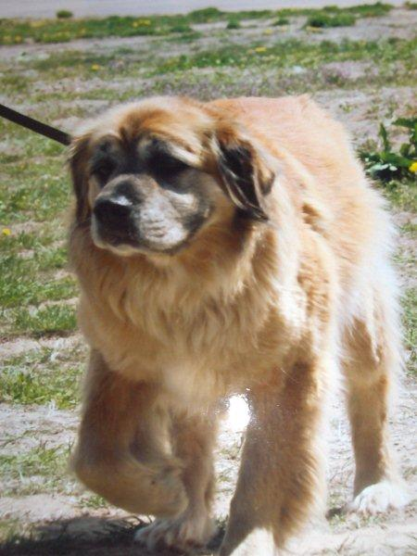
REGION 6 Maxine Lady
Owner/Handlers
Shirley Webber

Slide 7
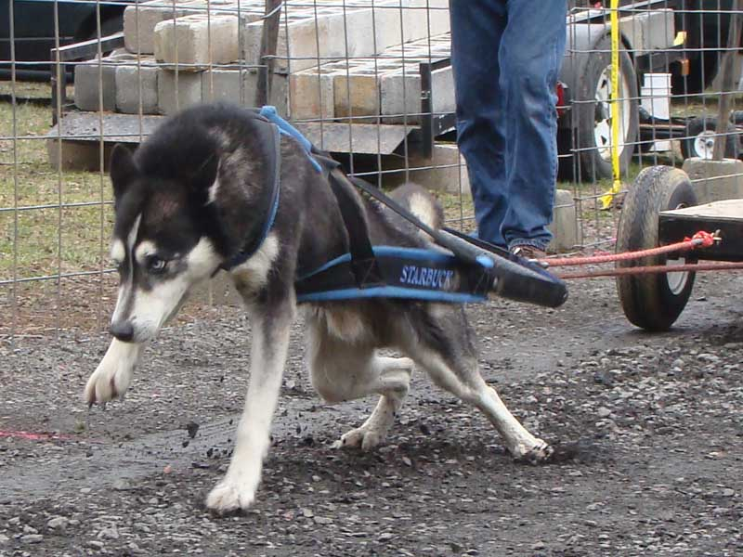
REGION 5 Starbuck
Owner/Handler
Steve Jackson

Slide 8
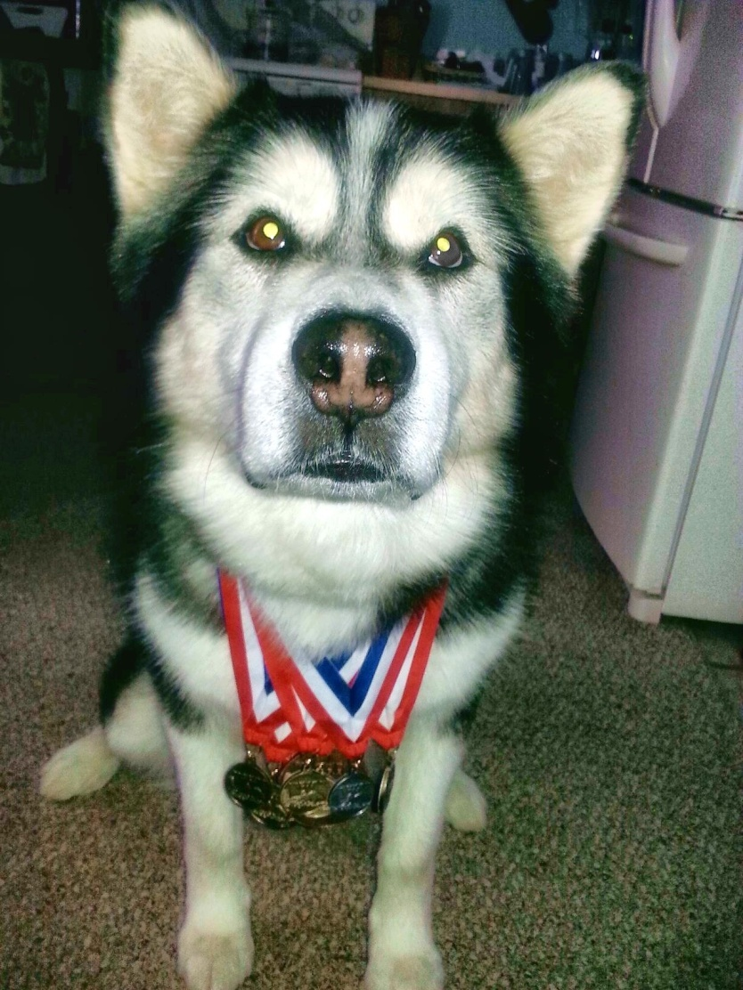
REGION 11 Raider
Owner/Handler
Valarie Thawley

Slide 9
IWPA International Hall of Fame Inductee’s
2012 – 2013 Season

Slide 10
June 1, 2013 International Hall of Fame inductee’s
2012 – 2013 Season

Slide 11
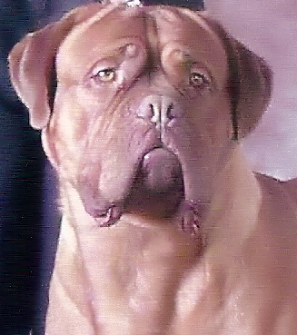
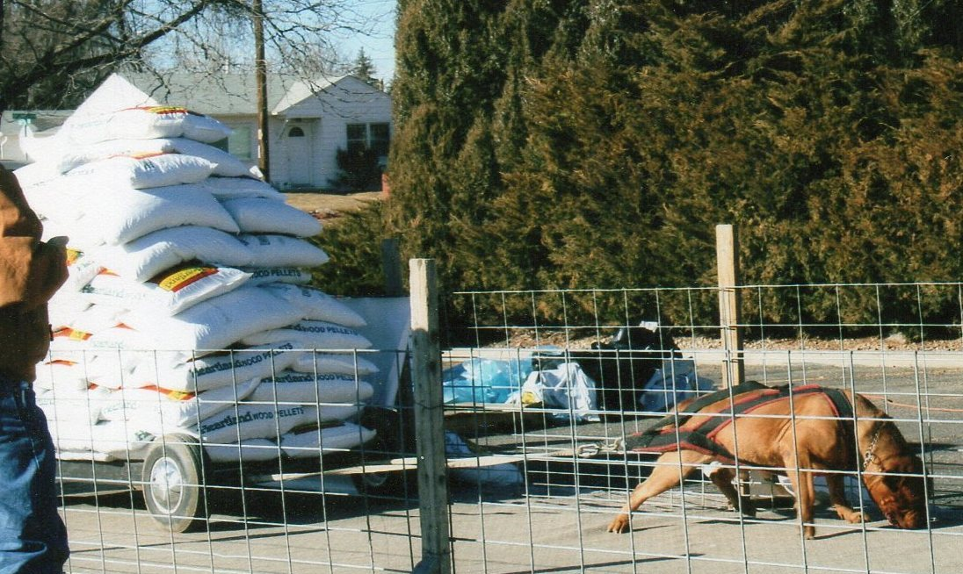
CH. Mount Sinai Dukes of Gold aka “King Dukes”
Owner/Handler:
Terry Reed

Slide 12
Miss Rose Petal Martin
Owner/Handler
Cheryl Martin

Slide 13
The IWPA International Hall of Fame inductees will be discussed during the Board Meeting in June and will be announced in the August Pulling Power Newsletter
Congratulations to all Regional Hall of Fame recipients!!!

